Slide 1
3.6 Two issues with the negative gradient as a descent direction

Slide 2
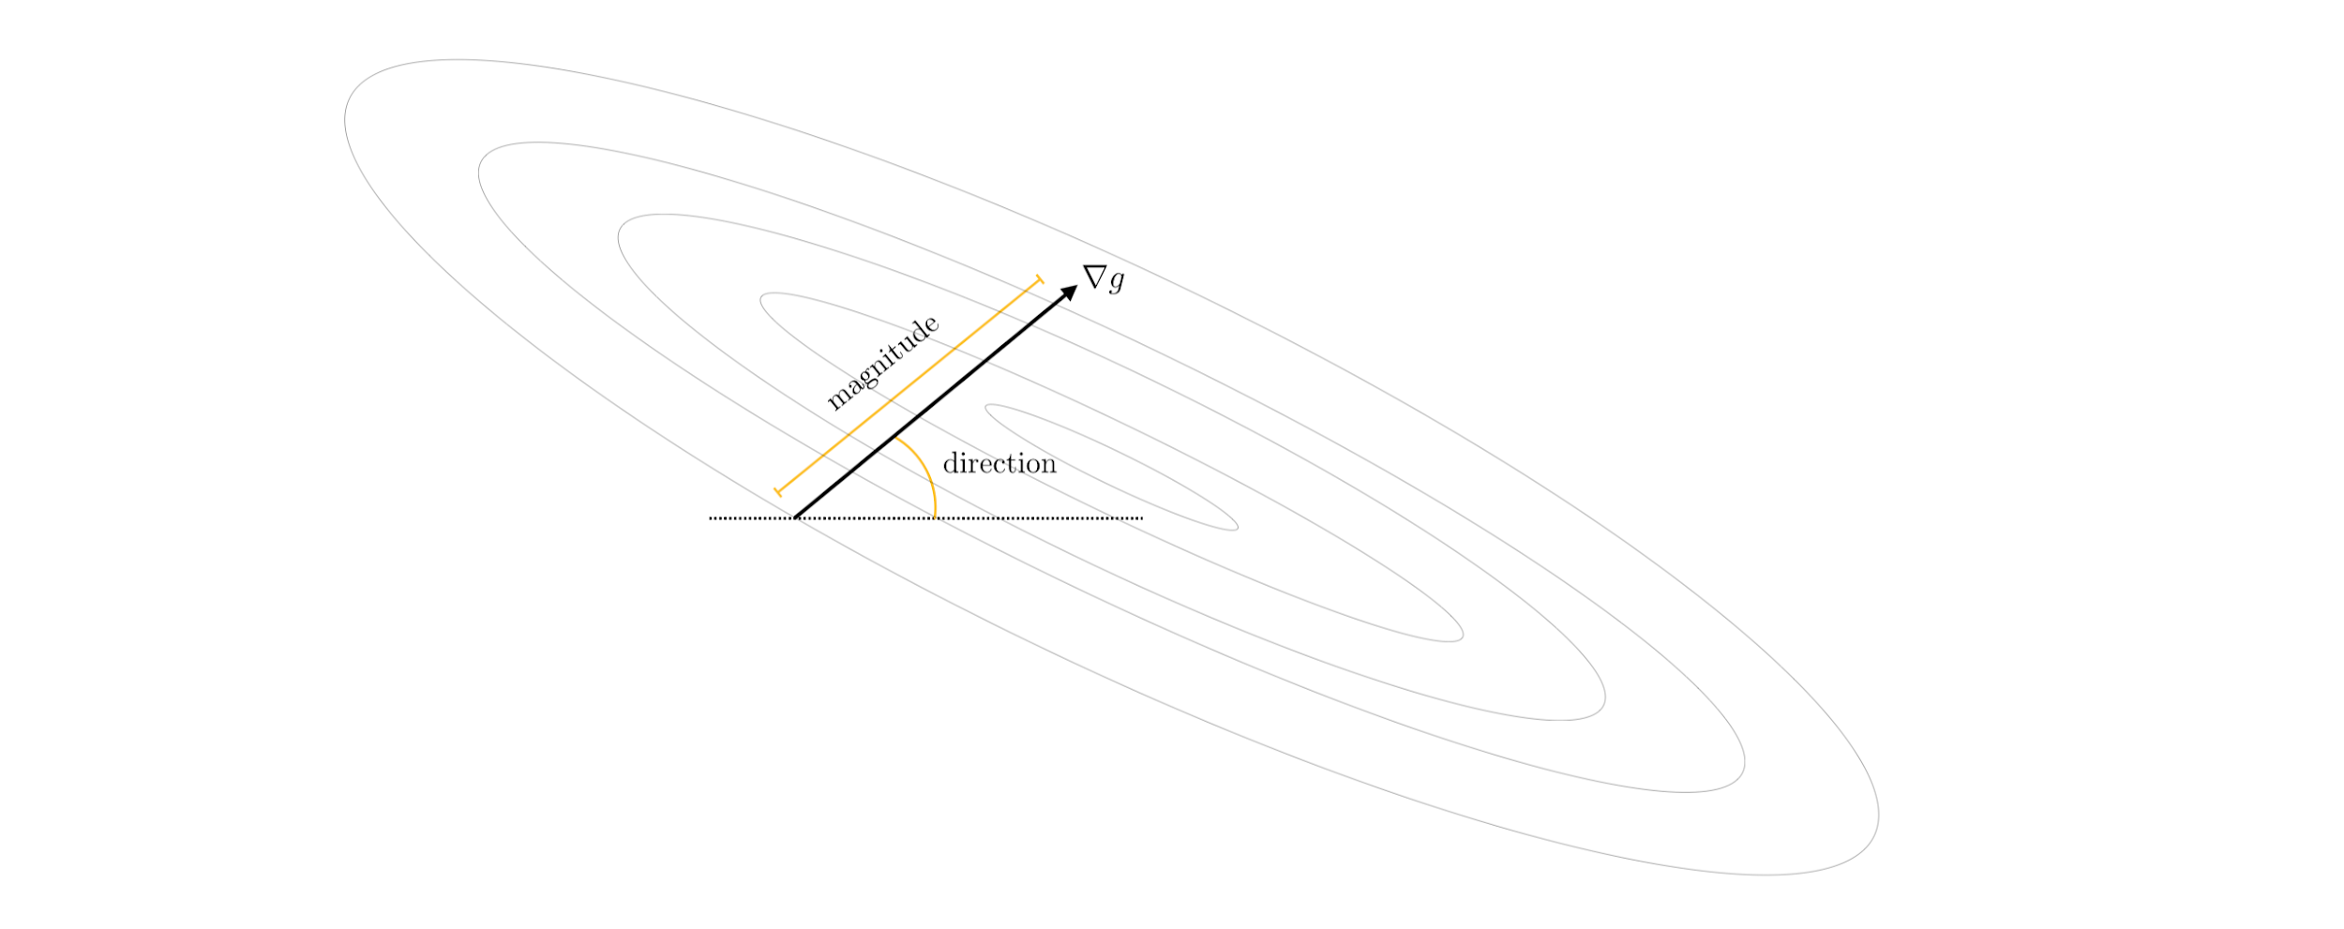
The negative gradient is not without its weaknesses as a descent direction, and in this Section we outline two significant problems with it that can arise in practice.
Like any vector the negative gradient always consists fundamentally of a direction and a magnitude.

Slide 3
Depending on the function being minimized either one of these attributes - or both - can present challenges when using the negative gradient as a descent direction.
The direction of the negative gradient can rapidly oscillate or zig-zag during a run of gradient descent, often producing zig-zagging steps that take considerable time to reach a near mininum point.
The magnitude of the negative gradient can vanish rapidly near stationary points, leading gradient descent to slowly crawl near minima and saddle points.

Slide 4
These two problems present themselves in machine learning because many of the functions we aim to minimize have long narrow valleys, long flat areas where the contours of a function become increasingly parallel.

Slide 5
The (negative) gradient direction points perpendicular to the contours of any function

Slide 6
A fundamental property of the (negative) gradient direction is that it always points perpendicular the contours of a function.
This statement is universally true - and holds for any function and at all of its inputs.
We illustrate this fact via several examples below.

Slide 7
Example: Gradient descent directions on the contour plot of a quadratic function

Slide 8
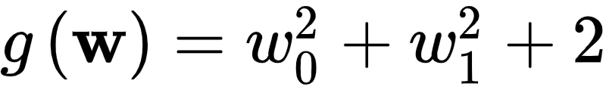
Below we show , with gradient descent directions defined at three random points.
The contour plot is colored blue - with darker regions indicating where the function takes on larger values, and lighter regions where it takes on lower values.
Each of the points we choose are highlighted in a unique color, with the contour on which they sit on the function colored in the same manner.
The descent direction defined by the gradient is perpendicular at each point is drawn as an arrow and the tangent line to the contour at each input is also drawn.

Slide 9
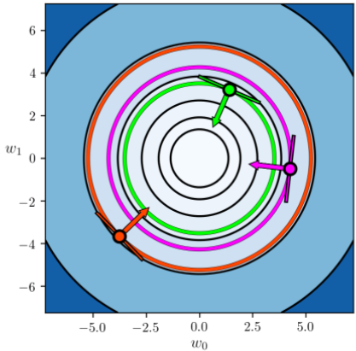

Slide 10
Example: Gradient descent directions on the contour plot of a wavy function

Slide 11
Here we show the contour plot and gradient descent directions in the same manner as the previous example for

Slide 12
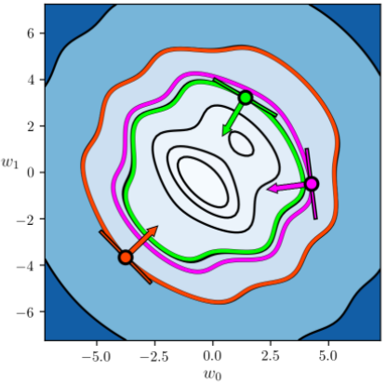

Slide 13
Example: Gradient descent directions on the contour plot of a standard non-convex test function

Slide 14
Finally we show the same sort of plot as in the previous example using the function

Slide 15
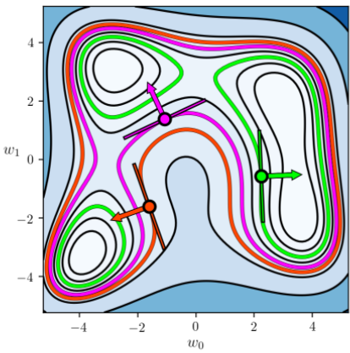

Slide 16
The 'zig-zagging' behavior of gradient descent

Slide 17
Because the negative gradient points perpendicular to the contours of a function can make the negative gradient direction oscillate rapidly or zig-zag during a run of gradient descent.
This in turn can cause zig-zagging behavior in the gradient descent steps themselves.
Too much zig-zagging slows minimization progress and - when it occurs - many gradient descent steps are required to adequately minimize a function.

Slide 18
Example: Zig-zagging behavior of gradient descent on three simple quadratic functions

Slide 19
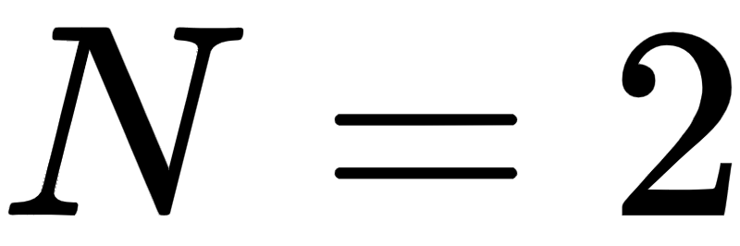

We illustrate the zig-zag behavior of gradient descent with three dimensional quadratic
.Not much progress is made with the third quadratic at all due to the large amount of zig-zagging.
We can also see the cause of this zig-zagging: the negative gradient direction constantly points perpindicular to the contours of the function (this can be especially seen in the third case).

Slide 20
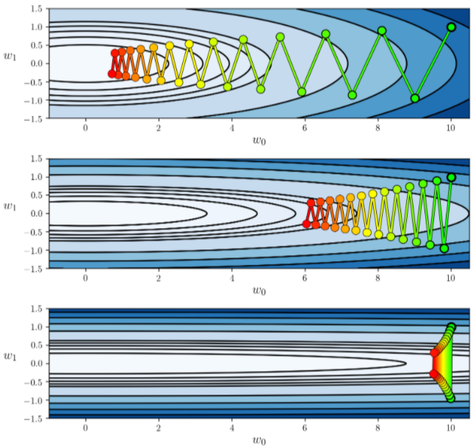

Slide 21
It is the true that we can ameilorate this zig-zagging behavior by reducing the steplength value, as shown below.
However this does not solve the underlying problem that zig-zagging produces - which is slow convergence.
Typically in order to ameliorate or even eliminate zig-zagging this way requires a very small steplength, which leads back to the fundamental problem of slow convergence.

Slide 22
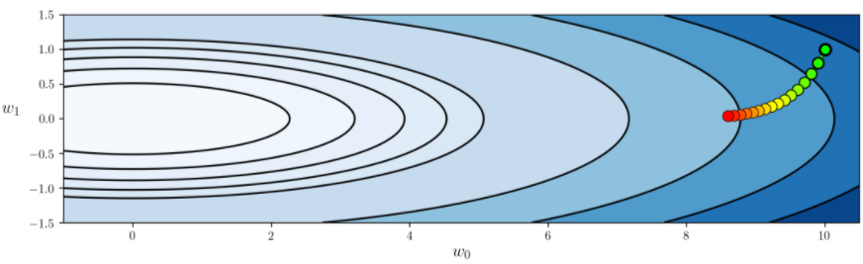

Slide 23
The slow-crawling behavior of gradient descent

Slide 24
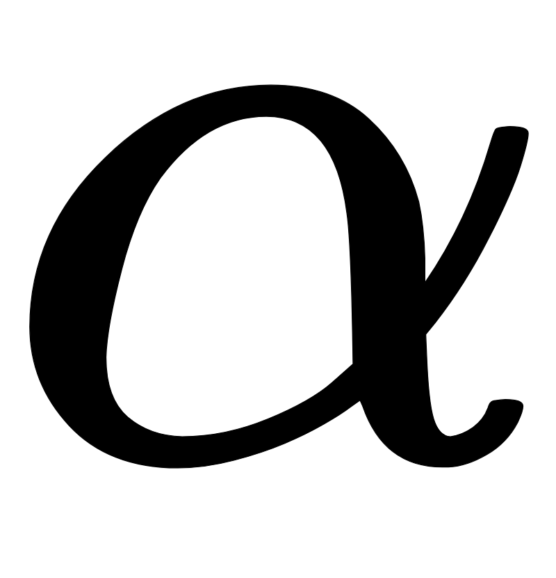
The first order condition for optimality discussed in [Section 3.2](https://jermwatt.github.io/machine_learning_refined/notes/3_First_order_methods/3_2_First.html), the (negative) gradient vanishes at stationary points.
The vanishing behavior of the negative gradient magnitude near stationary points has a natural consequence for gradient descent steps - they progress very slowly, or 'crawl', near stationary points.
This occurs because unlike the zero order methods discussed in the previous Chapter, the distance traveled during each step of gradient descent is not completely determined by the steplength / learning rate value .

Slide 25
This means that gradient descent steps make little progress towards minimization when near a stationary point
Thus depending on the function many of them may be required to complete minimization.

Slide 26
Example: Slow-crawling behavior of gradient descent near the minimum of a function

Slide 27
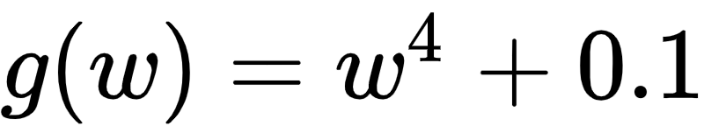
Below we show another example run of gradient descent using a function
whose minimum is at the origin.
This example shows how steps can be quite large far from a stationary point, but then get very small and crawls as we get closer and closer to the minimum of this function.

Slide 28
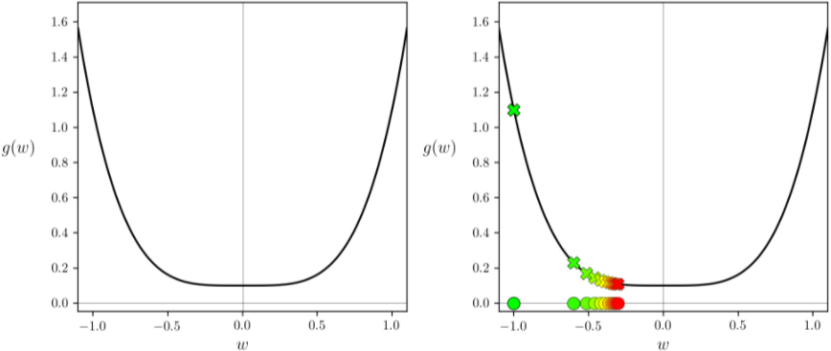

Slide 29
Example: Slow-crawling behavior of gradient descent near saddle points

Slide 30
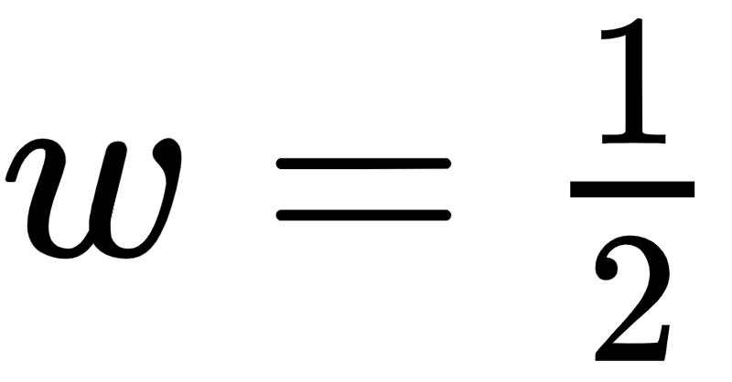
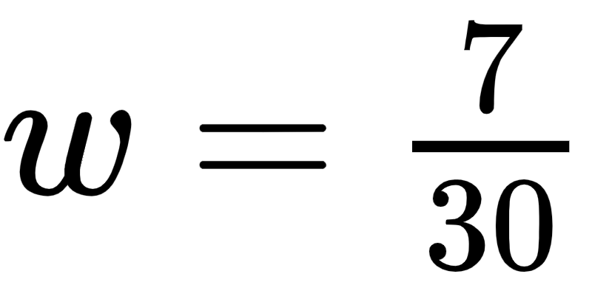
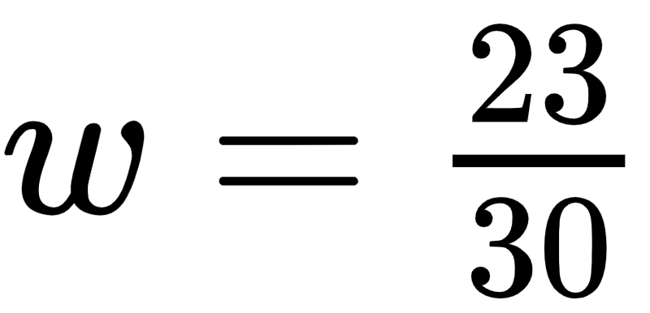
Now we illustrate the crawling issue of gradient descent near saddle points using the non-convex function
This function has a minimum at and saddle points at and
The fact that gradient descent crawls as it approaches this saddle point since the magnitude of the gradient vanishes here.

Slide 31
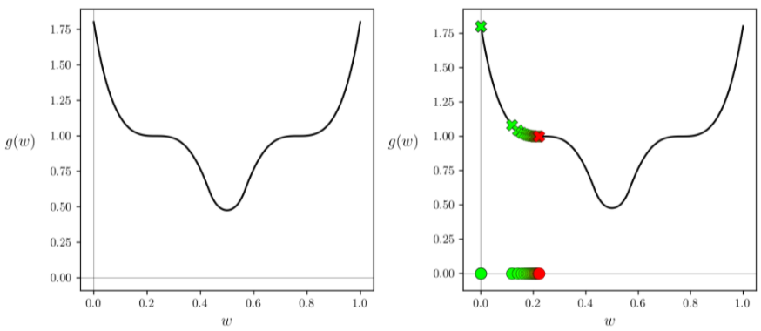

Slide 32
Example: Slow-crawling behavior of gradient descent in large flat regions of a function

Slide 33
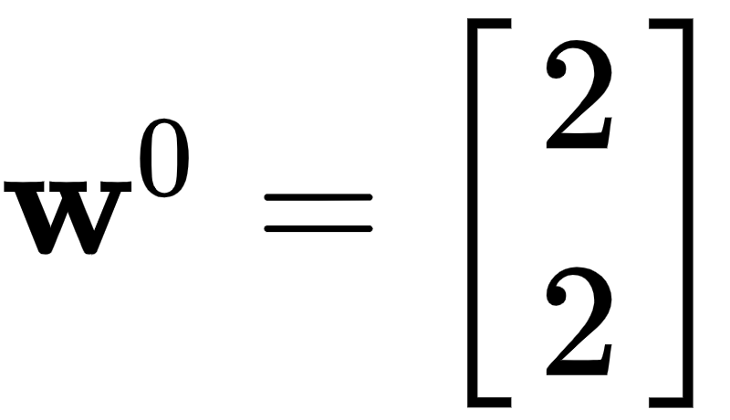
As another example, we attempt to minimize the function
via gradient descent starting at the point
The magnitude of the gradient being almost zero here, we cannot make much progress employing 1000 steps of gradient descent.

Slide 34
